Slide 1
Achieved,
& Ascribed
Prepared by Jimi Akinsanya

Slide 2
choice!
This is a word that occupies certainly our daily lives.

Slide 3

Some choices are made for us

Slide 4
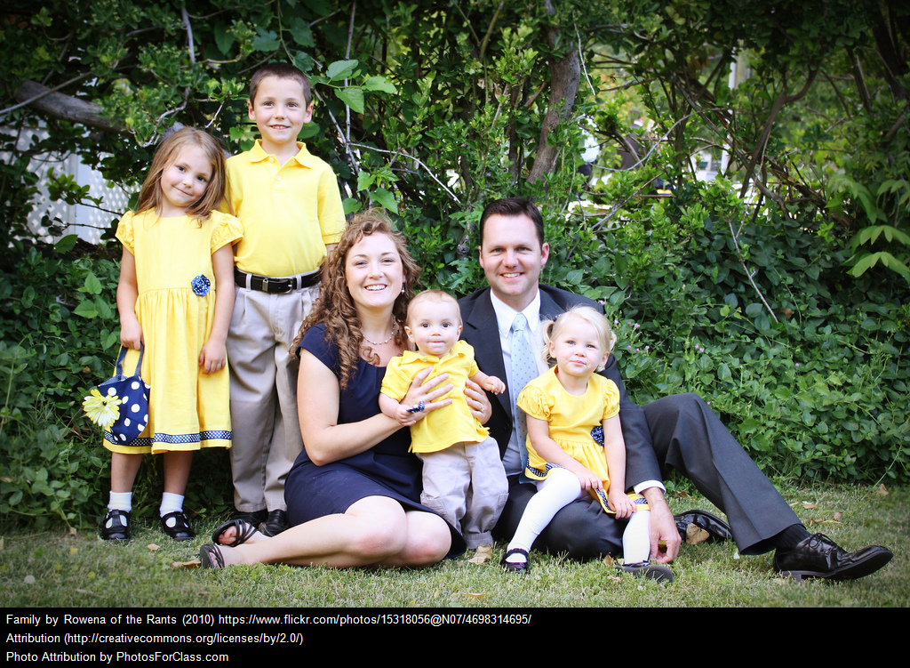
Like the family you are born into:

Slide 5
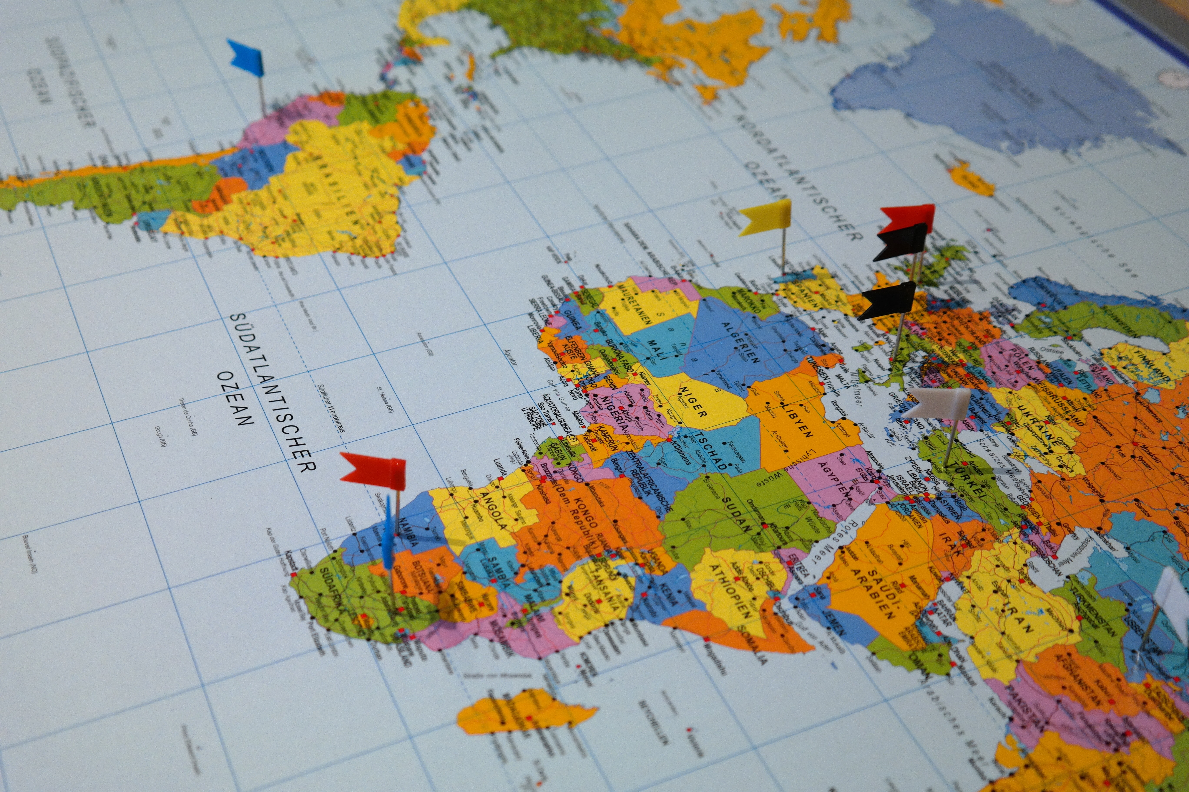
Country of birth/origin

Slide 6
Simply means, we have no control over these choices
It is called ASCRIBED status
But
Those choices we made for ourselves like:

Slide 7


School Grades
Career Path

Slide 8
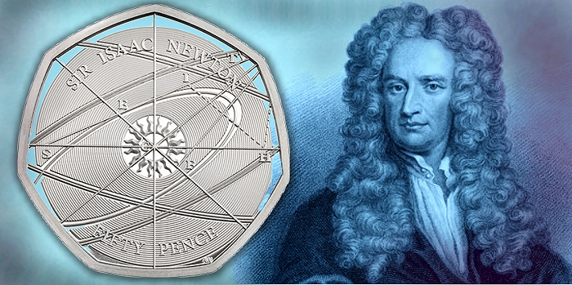
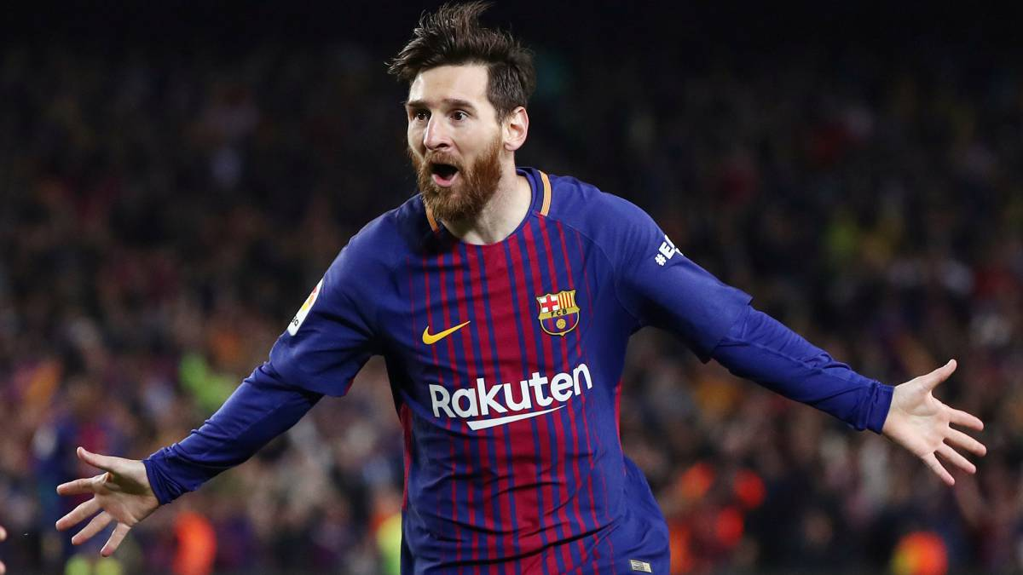
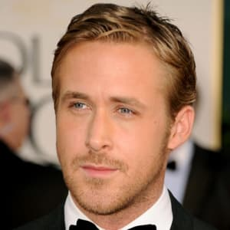
These choices make you an ACHIEVER like:
Sir Isaac Newton
Lionel Messi
Ryan Gosling

Slide 9
ACHIEVED STATUS is the best way you can proof you conquer life !
You will much be remembered for what you have achieved with the choices you made!
Let your CHOICES be guided by what you want to ACHIEVE and you will be glad with your CHOICES & amazed by your ACHIEVEMENT.

Slide 10
Thank you!

